Slide 1
EEG Source Localization Algorithm based on 3D-Grid Source Model
Qinyuan (David) Wei
Supervisor: Nicole Zhou
Mentor: Wentai Liu
Date: 08/17/2017

Slide 2
Outline
Fieldtrip
Implementation of MCE & LCMV
Results & analysis
Next steps

Slide 3
Fieldtrip
Source localization steps:
Read data
Compute lead field matrix
Generate sources (optional)
Compute forward model
Apply inverse method
MNE, MCE, LCMV···
Plot results
Notes:
The first step is reading data, includes source model, head model, electrodes positions and potentials.
If you don’t have real eeg data, you can generate the ground truth yourself, then compute the forward model to get the simulated electrodes potentials.

Slide 4
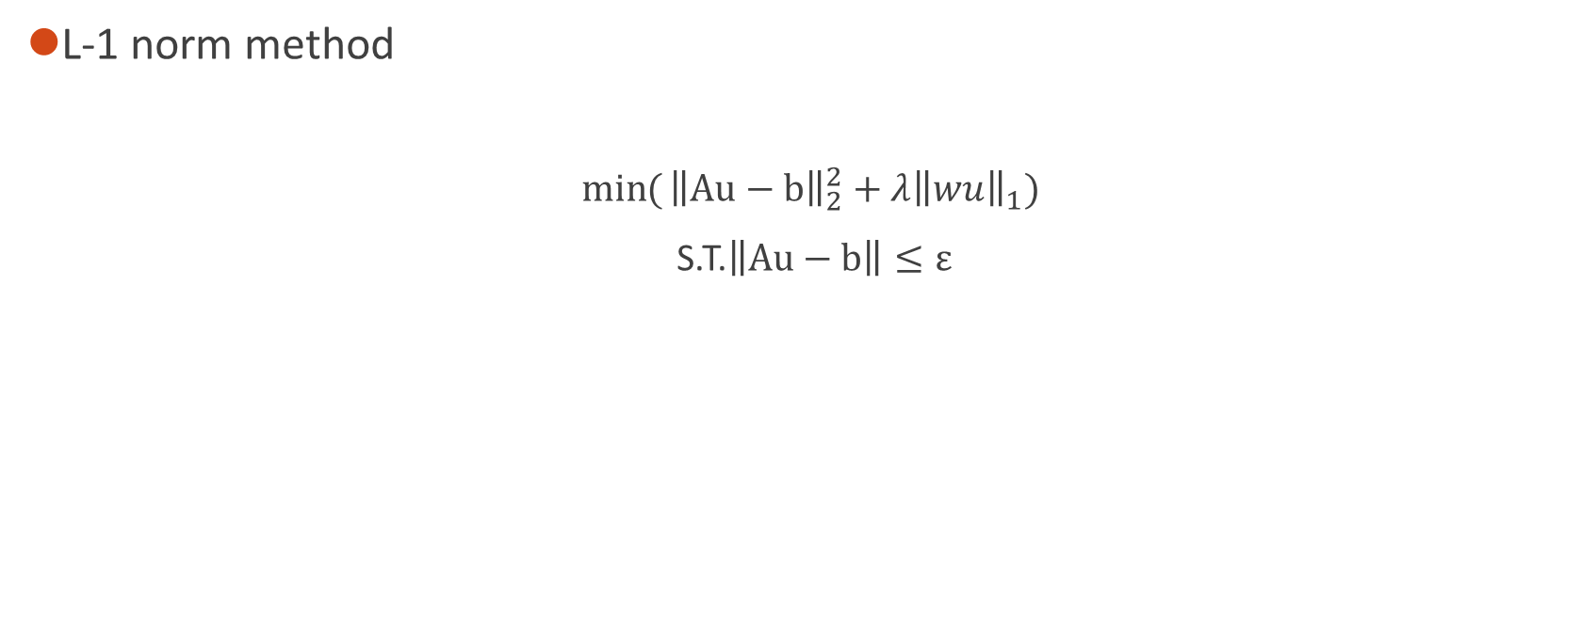
MCE
L-1 norm method
$\min{(}{\left\|Au−b\right\|}_{2}^{2}+λ{\left\|wu\right\|}_{1})$
S.T.$\left\|Au−b\right\|≤ε$
Notes:
Quick review of MCE method. It is a L1 norm method which means it is very sparse. And here is the optimization function.

Slide 5
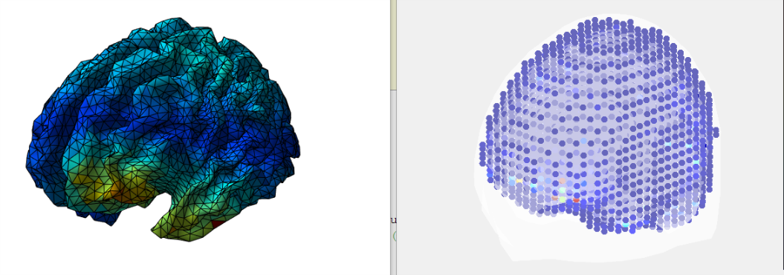
MCE
Results
2D
3D
Notes:
First I implement a real data, and this is the result. We can see the result of MCE matches the 2D localization result in the left, however, the following tests do not look this good.
The resolution of the source model is 8 mm and it has 10240 points.

Slide 6
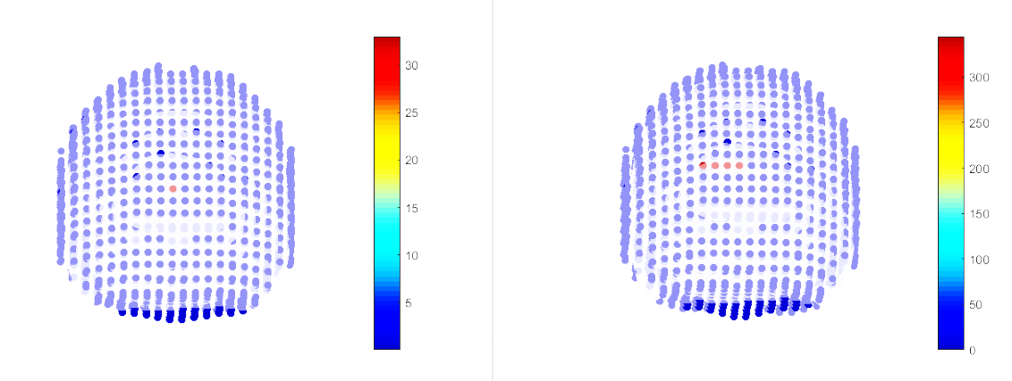
MCE
Results:
1 source on the surface
result
source
Notes:
And then I start to generate sources myself to test this algorithm. First I generate one source on the surface of the brain. As we can see in the picture, when there is one source on the surface of the brain, MCE can localize the source almost right, still has some deviation.

Slide 7
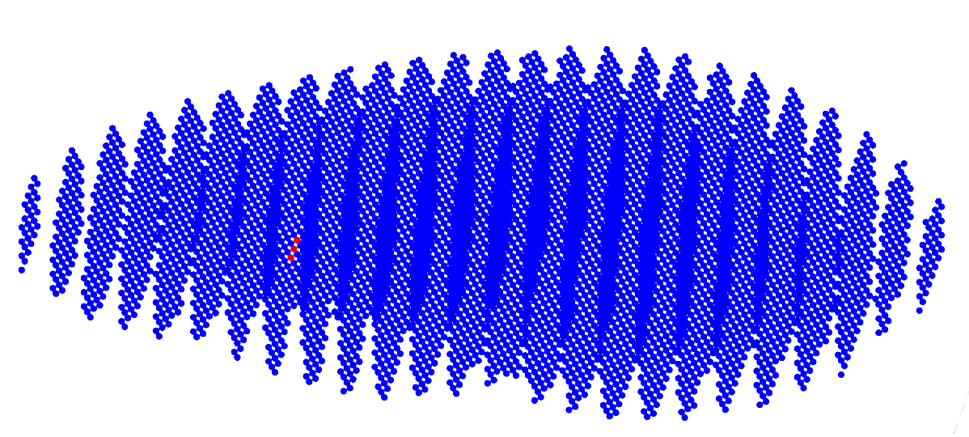
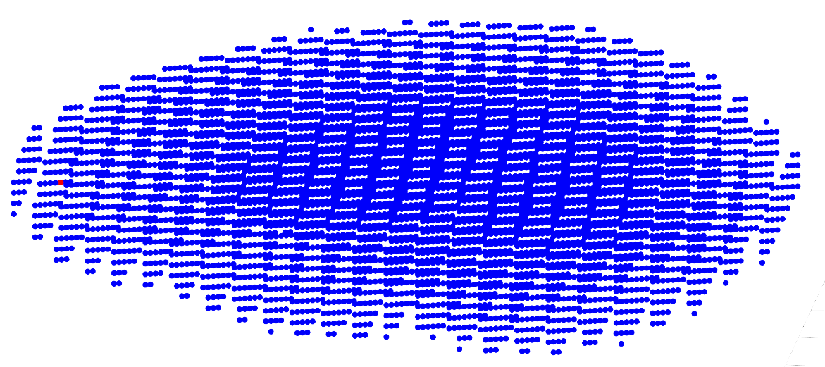
MCE
1 source in the deeper area
result
source
Notes:
When it comes to one source in the deeper area of the brain, the localization becomes very inaccurate.

Slide 8
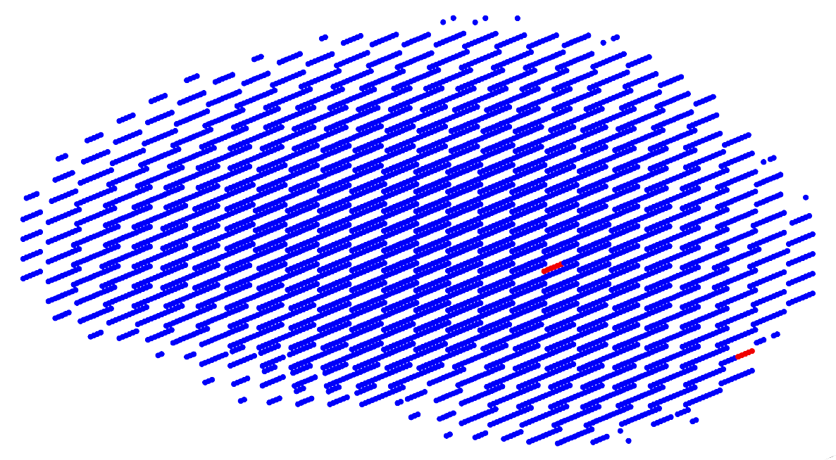
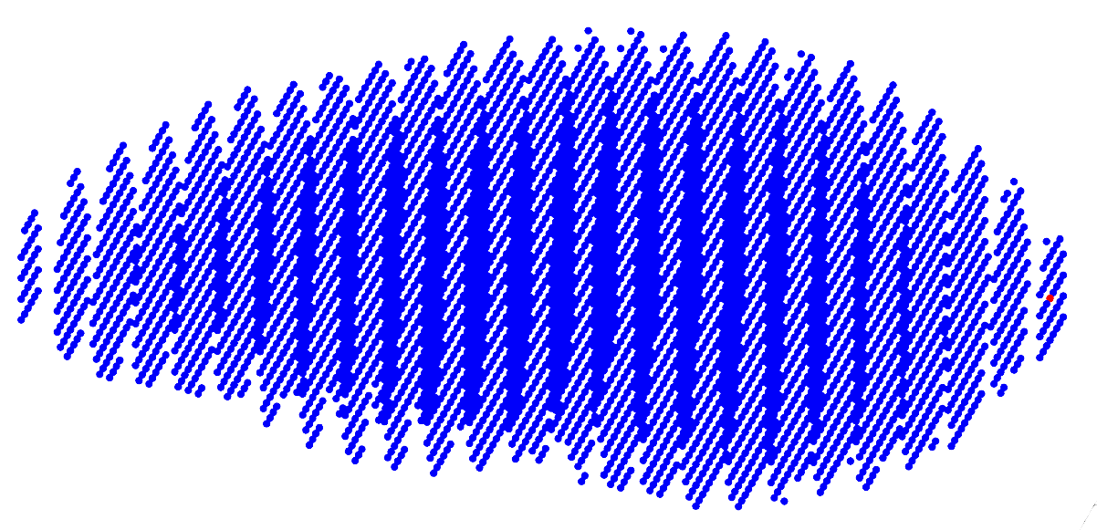
MCE
2 sources
result
source
Notes:
Them I test 2 sources in the brain. As we can see, the result is totally wrong. So I think MCE is not reliable here.
Also there are a lot of cases which can not run out a result. The result is totally wrong. This is because the iteration in the algorithm does not reach the threshold, which means this algorithm does not come out of a result.

Slide 9
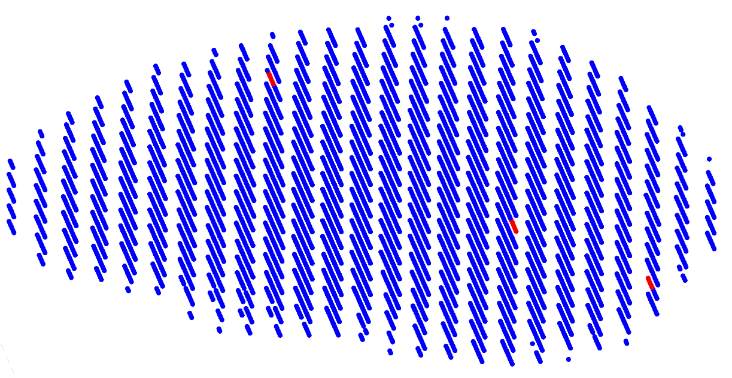
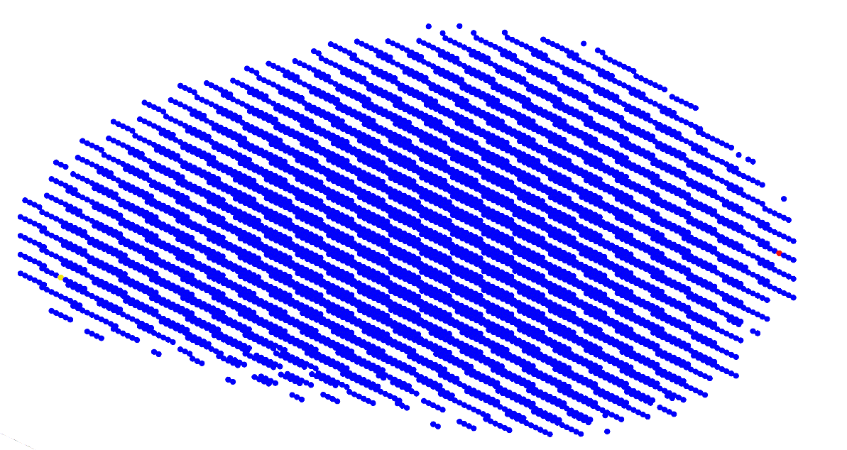
MCE
3 sources
result
source
Notes:
And here is the test of three sources, the result is also very bad, so I believe this MCE method cannot work in the 3D model.

Slide 10
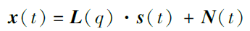
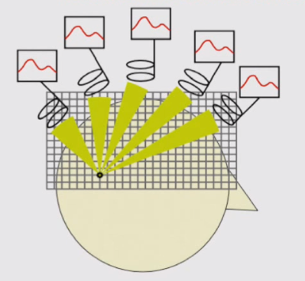
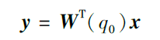
LCMV (Linearly Constrained Minimum Variance)
Principal
Spatial filtering
Notes:
Different from regularization methods, the idea of LCMV is beamforming which uses spatial filtering to calculate the source location. The algorithm aims to find a spatial filter in each source location q in the brain , as the W in the function. The output Y means the power of sources in the brain, which contains the information of the source location.
1997，Barry D. Van Veen,*

Slide 11
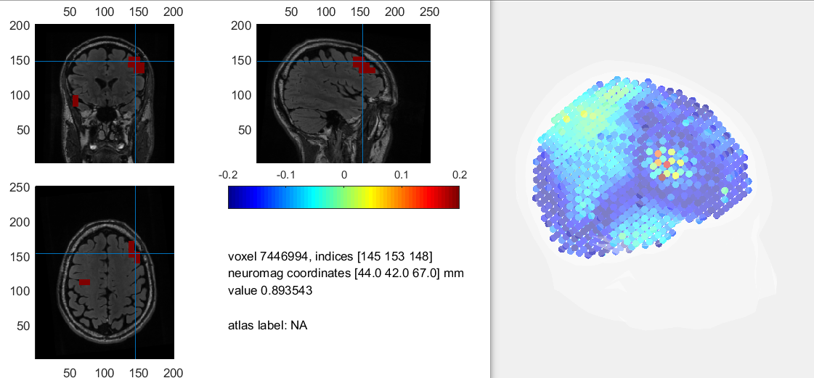
LCMV
Implementing a real dataset from fieldtrip:
Notes:
Also I implement this method.
This is the result of a real data which is download from fieldtrip and it can demonstrate the performance of LCMV. The results looks good. It seems that this is a good method in 3D model, and we need to do more tests on it.
The data is from the test of monitoring the movement when you press buttons with your hand.
8mm resolution, 7038 points inside the brain.

Slide 12
Conclusion
MCE is not reliable in 3D model
LCMV can have a good performance in 3D
Notes:
It still need to be tested on synthetic data.

Slide 13
Next
Continue testing LCMV
Implement Bayesian methods
Develop a method on 3D model

Slide 14
References
Van Veen B D, Van Drongelen W, Yuchtman M, et al. Localization of brain electrical activity via linearly constrained minimum variance spatial filtering[J]. IEEE transactions on bio-medical engineering, 1997, 44(9):867.

Slide 15
Thanks for your time

Slide 16
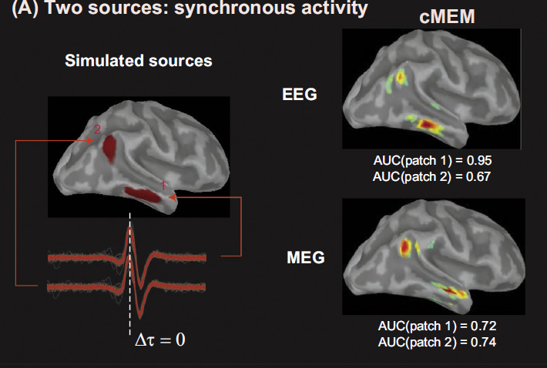
cMEM
(coherent Maximum Entropy on the Mean)
[2]
Notes:
cMEM (coherent Maximum Entropy on the Mean, 2013) is an improvement of MEM method. The MEM solver relies on a probabilistic (Bayesian) approach where inference on the current source intensities is estimated from the informational content in the data (notion of maximum of entropy).
The article I read suggests that cMEM is better than MNE and LORETA, which is more sparse and accurate.
And there is a matlab toolbox online.

Slide 17
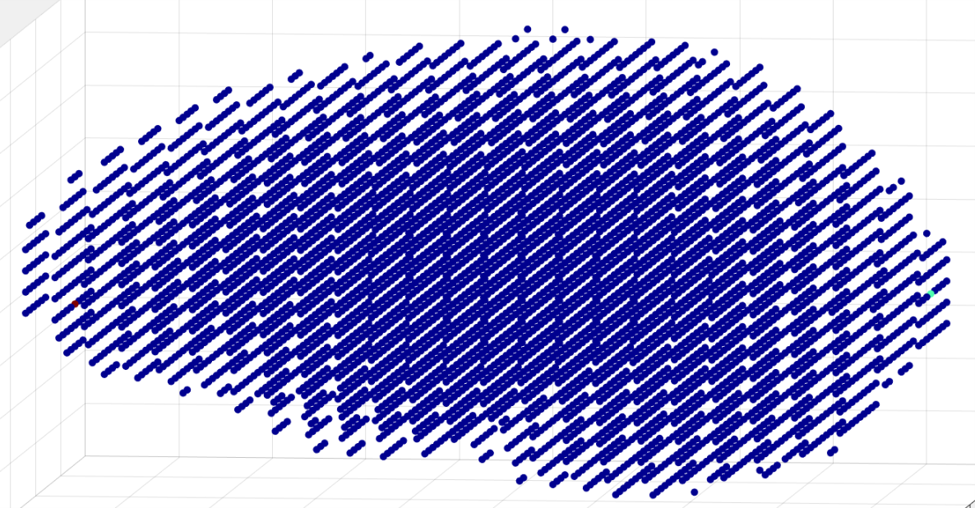
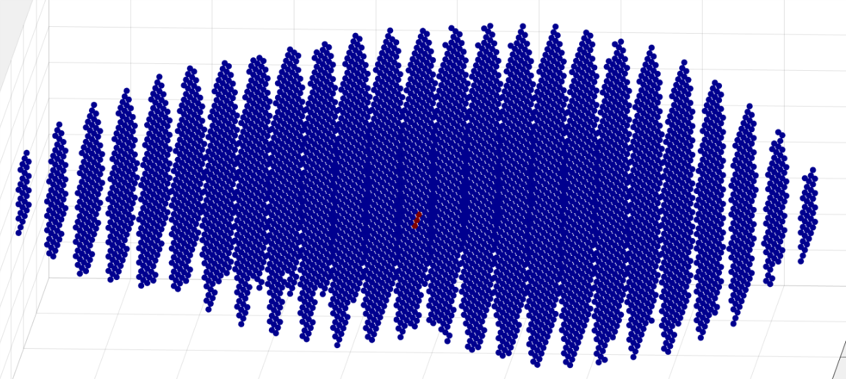

Slide 18
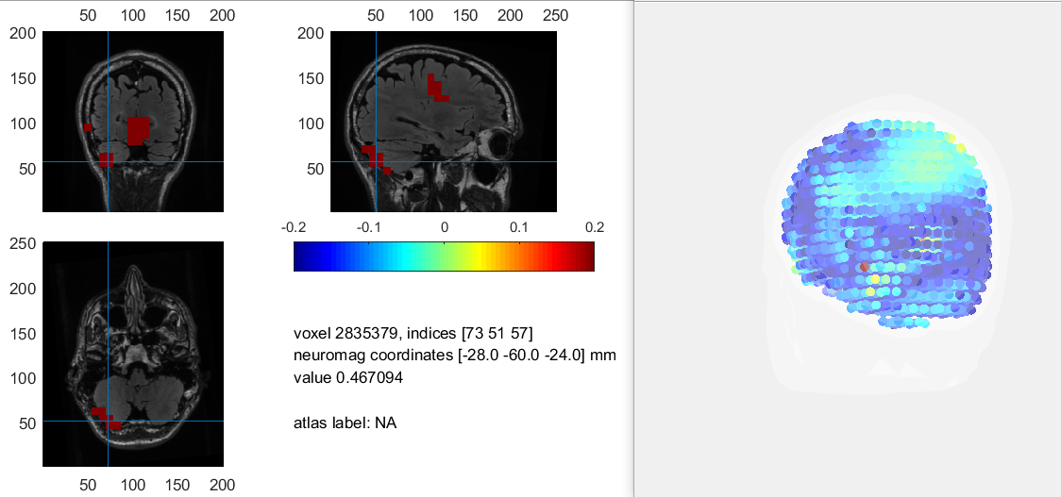

Slide 19
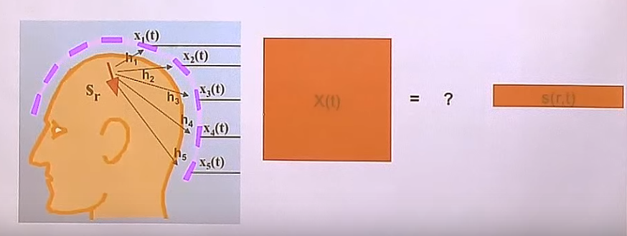

Slide 20
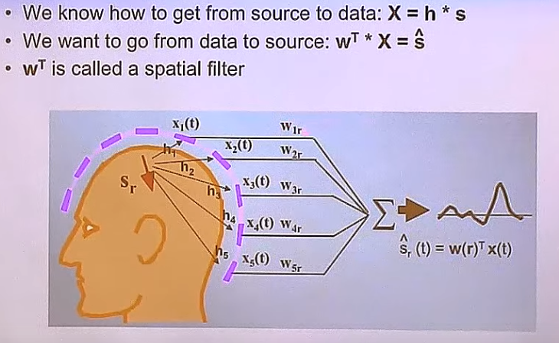

Slide 21
